Slide 1
Lab 4
Structuring Pytorch Projects
Prepared by:
Omar Samir

Slide 2
Agenda
Tensor Basics
Dataset and Data loader
Model Building
Loss and Optimizer
Training
Inference and Evaluation

Slide 3
Tensor basics
While working in machine learning and neural networks, we need to represent our data with vectors
You probably know about numpy arrays and and how we can do vector operations using numpy
In pytorch, vectors can be represented with tensors and all operations you know can be done directly on tensors

Slide 4
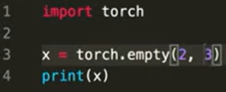
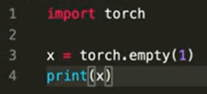
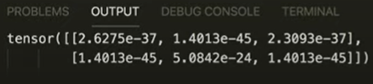

Tensor Basics
Creating empty tensors

Slide 5
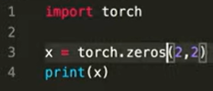
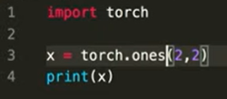
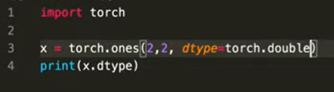
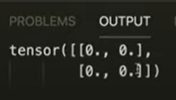


Tensor Basics
Creating tensors

Slide 6
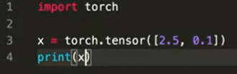

Tensor Basics
Creating tensors

Slide 7
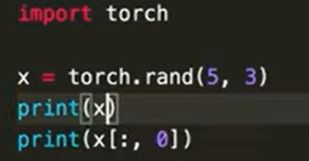
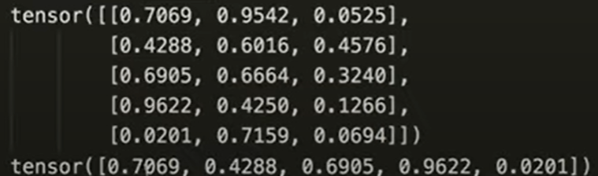
Tensor Basics
Tensor operations
z = x + y (element wise addition)
z = x - y (element wise subtraction)
z = torch.add(x, y)
z = torch.sub(x, y)
y.mul_(x) (in place element wise multiplication)

Slide 8
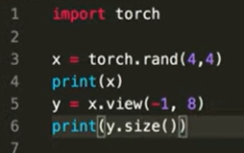
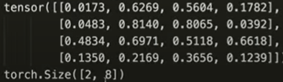
Tensor Basics
Tensor operations

Slide 9
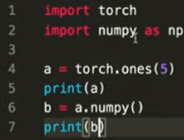

Tensor Basics
Creating numpy array from tensor
If on CPU, both objects share the same location
So a change in any element will affect the other one

Slide 10
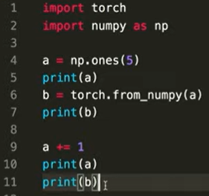
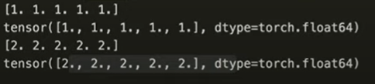
Tensor Basics
Creating tensor from numpy array

Slide 11
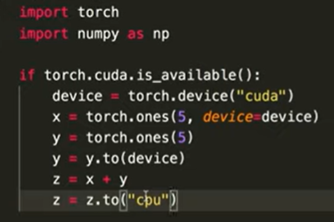
Tensor Basics
GPU and CPU

Slide 12
Model Training
The general framework for training your model is as follows
for epoch in range(num_epochs):
for i in range(num_batches):
Forward pass
Loss calculation
Backward pass
Weights update

Slide 13
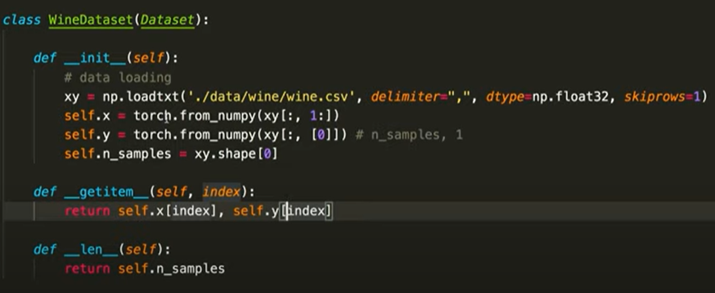
Dataset and DataLoader
Pytorch provides a very easy way to handle your dataset
>>> from torch.utils.data import Dataset, DataLoader

Slide 14
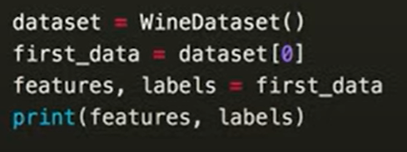
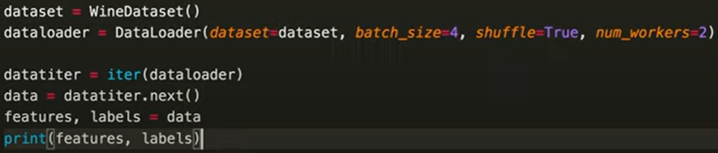
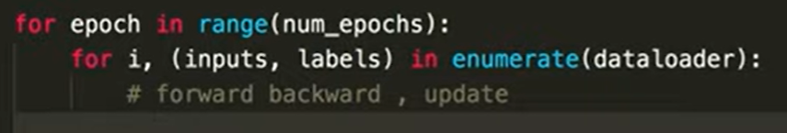
Dataset and DataLoader

Slide 15
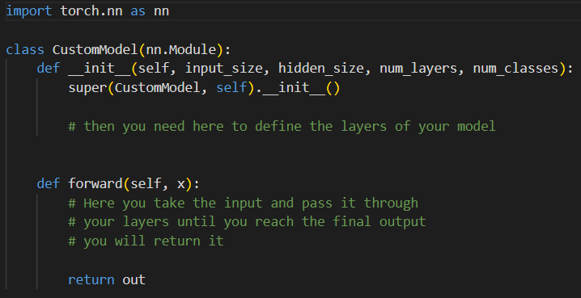
Model Building
To create your own model you need to implement your own class that inherits from torch.nn.Module

Slide 16
Model Building
torch.nn contains all types of neural network layers you will need to use
Recurrent Layers
nn.RNN
nn.LSTM
nn.GRU
Linear Layers
nn.Linear
Dropout Layers
Non-linear Activation layers
etc

Slide 17
Model Building
Example:
We need to build a model that classifies a given text using an RNN that takes the input tokens then we use the output of the last time step of the RNN and pass it to a linear layer to output the scores for each class.

Slide 18
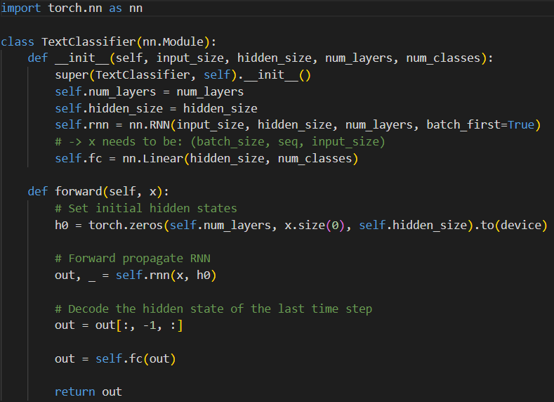
Model Building

Slide 19
Loss and Optimizer
After building the model, you need to define which loss function you will use for the training process.
Cross Entropy Loss
Mean Squared Error Loss
You need also to choose what optimizer to use
SGD
RMSProp
Adam
AdamW

Slide 20

Loss and Optimizer
For our text classifier example:

Slide 21
Training
To train your model you need to do nested loops over the total number of epochs and the total number of batches per epoch and for each batch you will need to do the following:
Collect your batch
Forward pass
Loss computation
Zero gradients
Backward pass
Weight updates

Slide 22
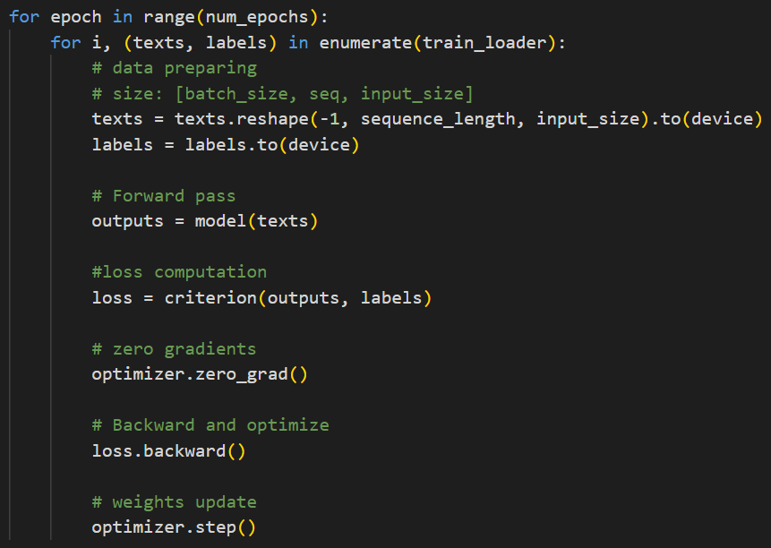
Training

Slide 23
Inference and Evaluation
To use your model in inference mode you need to do the following:
Work in the context of torch.no_grad()
Prepare you batch
Forward pass
Then you can use the output of your model for evaluation by calculating the metric your want (accuracy, recall, precision, F-score, etc.)

Slide 24
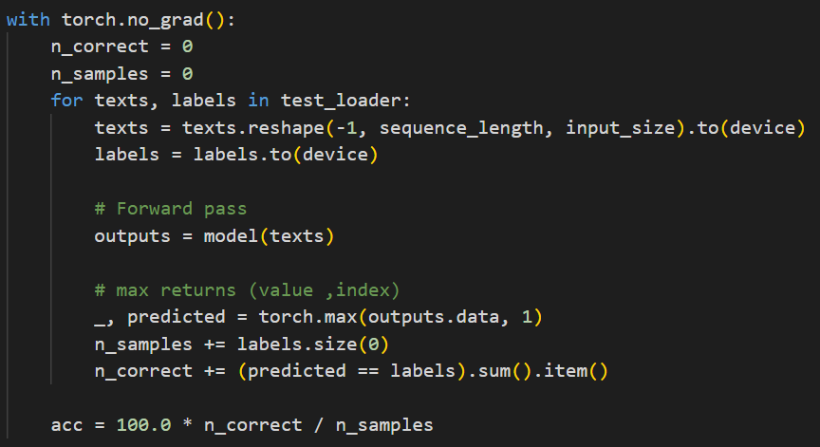
Inference and Evaluation

